Slide 2
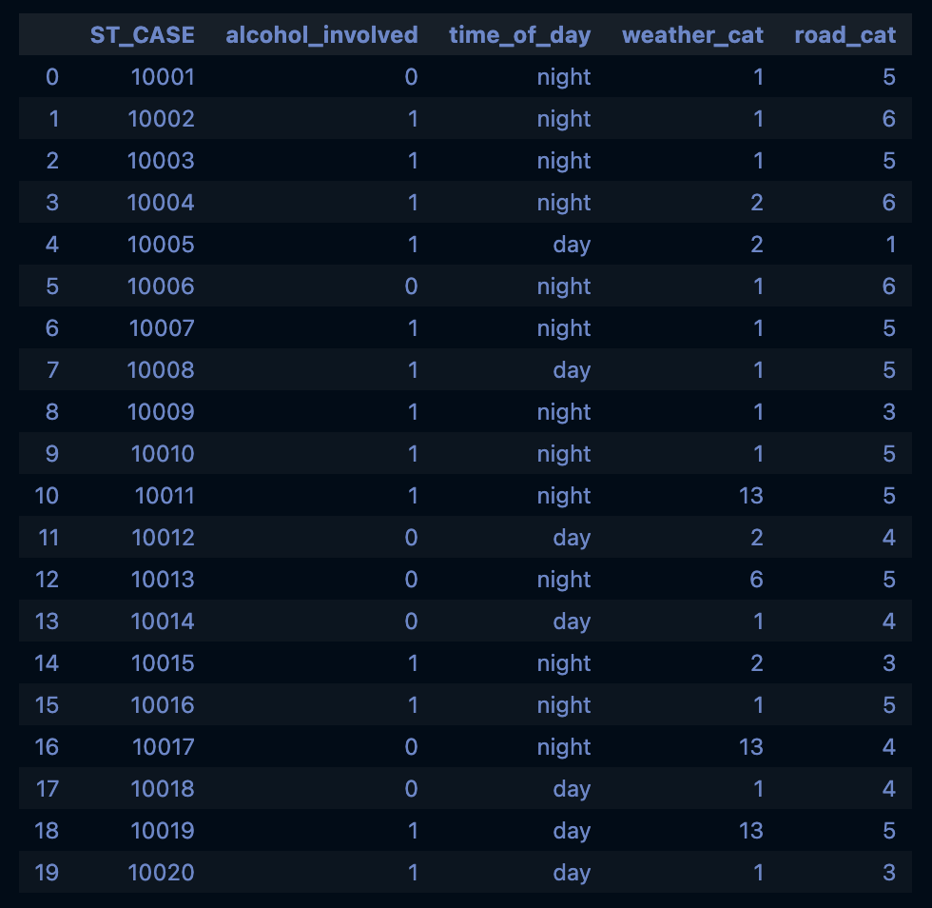
The data df_final: 37,654 rows × 5 columns X: 37,654 rows × 19 feature columns y: 37,654 labels

Slide 3
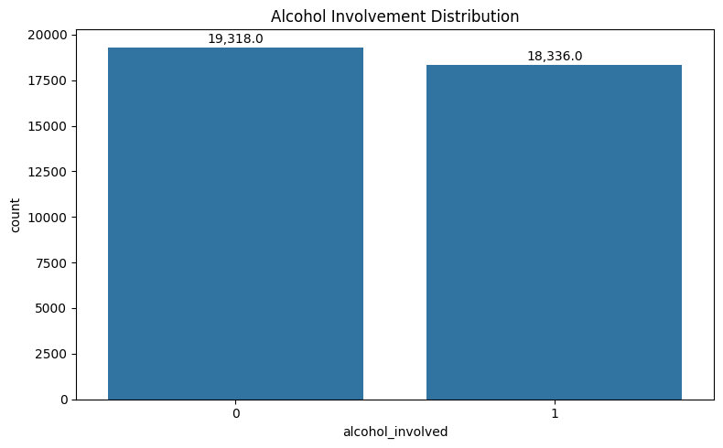
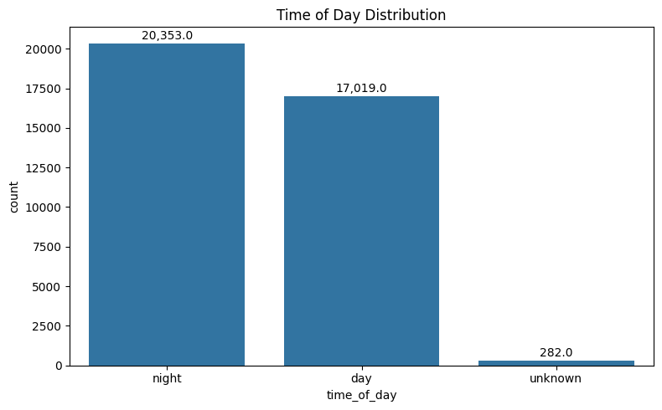
Alcohol Involvement and Time distribution
The graphs below depict how the data is split.

Slide 4
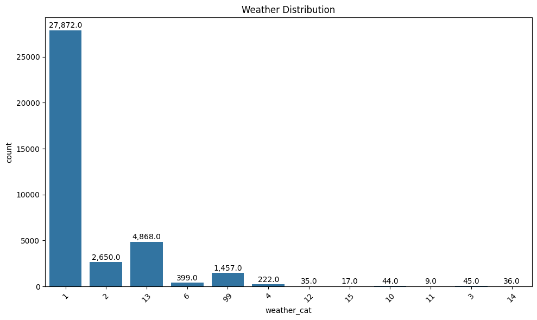
Weather Distribution
Code | Significance
1 | Clear
2 | Rain
4 | Fog/Smog/Smoke
6 | Blowing Snow
12 | Freezing Rain
13 | Sleet/Hail
14 | Blowing Sand/Dirt
15 | Severe Crosswinds
99 | Unknown

Slide 5

Supervised Learning

Slide 6
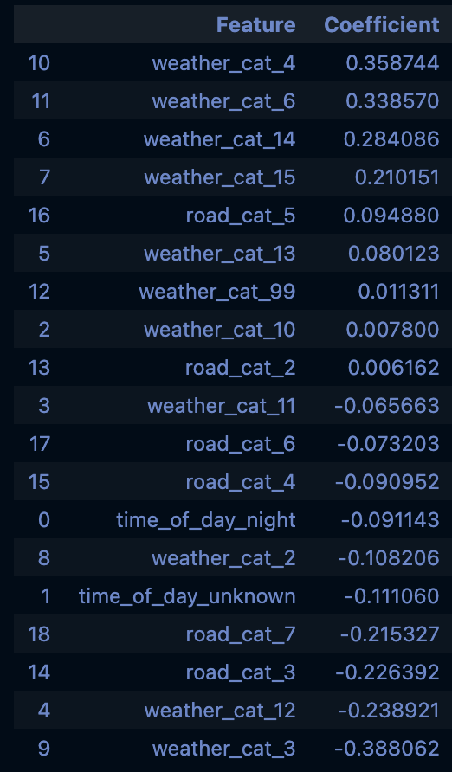
Alcohol and weather relation
Weather category 4 (Fog/Smoke/etc.) has a higher association with alcohol involvement than Weather category 3 (Rain/Sleet/etc.)
Meaning:
Among all alcohol-related fatal crashes, weather code 4 shows up proportionally more often than weather code 3.

Slide 7
Unsupervised Learning

Slide 8
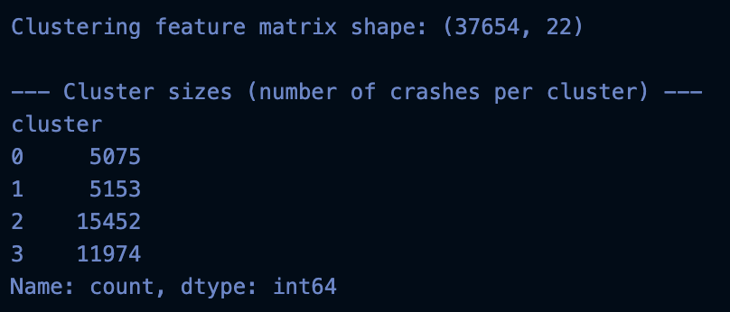

Slide 9
